Slide 1

QUALITY MEASUREMENT OF TRANSPORTATION SERVICE APPLICATION USING ISO 25010 QUALITY MODEL (CASE STUDI: GO-JEK)
Millati Izzatillah, S.Kom
92215016
Business Information System
Supervisor: Dr. Renny Nur’ainy, SE., MM

Slide 2

Background
Indonesia has become one of the countries which encourage the growth of mobile application.
One of Mobile apps is most widely used in Indonesia is Transportation service application
68%
Mobile Apps
Users in
Indonesia
Age: 20-40 years
Research results from Indonesia Growth for Knowledge
(GfK)
Notes:
- Transportation service application is an application that provides a variety
of services to vehicle sharing system at a time and in a short time
- Transportation service application has been widely used by Indonesian society,
Jakarta city and surrounding areas. The existence of transportation
service application provides many benefits such as transportation costs tend
to be cheaper, booking transportation service easily, efficient and fast.

Slide 3





Background
21.60%
6.04%
0.97%
0.64%
0.37%
Research results from Indonesia Growth for Knowledge (GfK)
Notes:
Use of GO-JEK application has a very high intensity when viewed from the
total users of transportation service application that used in Indonesia

Slide 4

Background
GO-JEK has 12 services
Notes:
GO-JEK also has 12 services include many functions
that must running well. The services can be ordered by multiple users in the
same time. Based on these conditions quality of GO-JEK application need
to be measured that all functions running properly and correctly resulting in
better application performance

Slide 5
Background
Very High Intensity of Use, GO-JEK application need
to be measured that all functions running properly and correctly resulting in
better application performance.
Does the quality of GO-JEK application Already Qualified based on the quality of international standardization such as ISO 25010?
QUALITY MEASUREMENT OF
TRANSPORTATION SERVICE APPLICATION GO-JEK
USING ISO 25010 QUALITY MODEL
“ISO 25010 is the latest standard and relevant to test the mobile application replaces the previous standard ISO 9126”
(veeneendaal, 2014)

Slide 6
Problem identification
Whether the GO-JEK application has a good quality based on ISO 25010 Quality Model ?
Notes:
Based on the background above
- For developer, how to produce software
with good quality in accordance with ISO 25010 Quality Model.?
faced by the user, how to determine the quality of the software used.
Whether the application has a good quality in terms of functionality,
performance, compatibility, usability, reliability, security, maintainability,
portability, effectiveness, efficiency, satisfaction, freedom from risk,
context coverage,
- so it really can help the user’s activity in the process of booking services on the application.

Slide 7
Research scope
Measurement of software quality is the transportation service application GO-JEK.
Measurement of software quality is using a model of ISO 25010.
The population used in this research is GO-JEK users in Indonesia who have the educational Information Technology background.
Questionnaires filled out by 100 respondents using purposive sampling technique.
Samples are transportation services application GO-JEK users who have the educational Information Technology background and domicile in Jakarta and surrounding areas (Depok, Tangerang, Bekasi).

Slide 8
Statement of problem
How to determine the relative weight characteristics and sub characteristics while measurement of software quality using ISO 25010 Quality Model?
How to know the characteristics and sub characteristics are to be used to measure the quality of transportation service application GO-JEK based on ISO 25010 Quality Model?
How to test the transportation service application GO-JEK from characteristics and sub characteristics ISO 25010 Quality Model to get quality value?
How to analyze data from the testing result of characteristics and sub characteristics ISO 25010 Quality Model?

Slide 9
Research Objectives
Measure the Product Quality and Quality in Use of transportation service application GO-JEK using ISO 25010 Quality Model.
Proving whether the GO-JEK application already fulfil quality standard based on international standardization and see what characteristics influence the application with reference to ISO 25010 Quality Model
Notes:
So it provides information and guidance for
developers transportation service application on the characteristics which
must be considered in the development of mobile application transportation
service.

Slide 10
Research Benefits
For developer
For author
For academics
Can be used as a reference for measuring the quality of a mobile application, especially transportation service application.
For user
contributed to the development of the quality measurement of transportation services application literature in Indonesia.
Provide feedback information on the response given by user.
The feedback can be materials for improving of better performance in the application development .
The feedback also can be a reference for other developers about characteristics that will become the benchmark from transportation service application quality.
Provide information that will be considered in using the application as needed

Slide 11
QUALITY MODEL
Mc Call
(1977)
Boehm
(1978)
ISO 9126
(2000)
ISO 25010
(2010)
Notes:
Typically, software
quality have been identified as follows [21]:
1. Compliance with Specification: Quality is defined as the product and services that are measurable, and characteristics that have determined specification.
2. User Requirement: Quality is identified irrespective of measurable characteristics. It defines quality as the ability of a product or service
to fulfil customer expectations explicitly or not.
Quality model that has international standardization can be trusted reference while measuring software quality. International quality models that often
used are

Slide 12
ISO 25010 quality model
International Organization for Standardization (ISO) and International Electrotechnical Commission (IEC) has established ISO / IEC standards related to software quality.
ISO / IEC 25010: 2010 (ISO 25010) is part of a series known as Software Quality Requirements and Evaluation (Square)
ISO 25010 is an extension of ISO 9126. ISO 25010 has two main dimensions: Product Quality and Quality in Use (QinU).
Product Quality defines the basic characteristics of a product.
Quality in Use defining characteristics related to the human interaction with the system
Notes:
ISO 25010 Quality Model has the most complete characteristics than the other quality models because there are 26 of the 29 factors
Char efficiency, portability and reliability are characteristics of the quality that appears in all models.
The new characteristics have been included in ISO 25010 is security and compatibility.
hierarchy of characteristics and sub characteristics in restructure with the purpose to improve the understanding of related concepts.

Slide 13
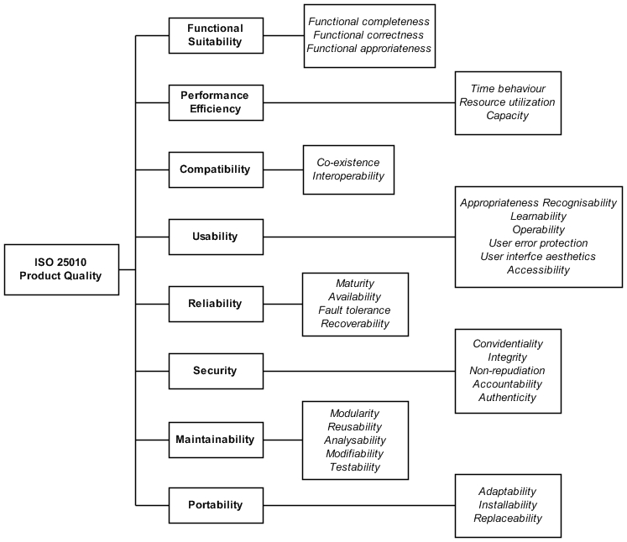
Product quality
Product Quality refers to the internal and external characteristics
of software that defines the quality of developer viewpoint
Notes:
8 char 31 sub

Slide 14
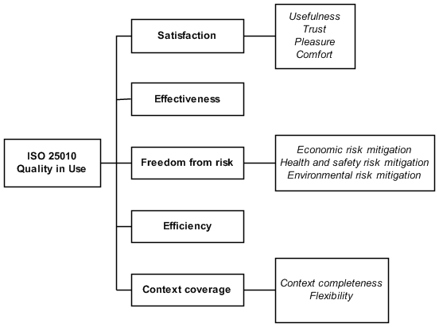
Quality in use
Quality in Use refers to the users perspective to evaluate the quality of
a system or software.
Notes:
5 char 11 sub

Slide 15
Research Object
Version 2.4
wih minimum Android 4.0
and minimum iOS 7.0

Slide 16
Population and Sample
POPULATION
All GO-JEK users in Indonesia
12.090.218 Million
SAMPLE
All GO-JEK users in Indonesia which has the Information Technology educational Background. that domiciled in Jakarta and surrounding areas (Depok, Tangerang, Bekasi).
Purposive sampling techniques
100 respondents using Slovin Formula

Slide 17
Data Collecting Method
The requirement of data collections were obtained in two ways, that is primary and secondary data collection.
Primary Data
Secondary Data
Questionnaires
&
Observation
Literature Study
Notes:
Observations on this research used to test the quality of a transportation
service application on characteristics Functional Suitability, Performance Efficiency,
Reliability, Compatibility and Security. The observations were made
by author to directly observe the application to be tested by creating a test
case for each sub characteristics on ISO 25010 Quality Model using black
box testing.
A questionnaire used to measure the characteristics Usability on Product
Quality dimension and all characteristics on Quality in Use such as Satisfaction,
Effectiveness, Freedom from risk, Efficiency, and Context coverage.
Literature Study used to obtain relative weighting characteristics-to understand the theories related to the Software
Quality Assurance (SQA) and testing technique obtained from scientific
journals, books, thesis, internet, and articles relating to research.

Slide 18
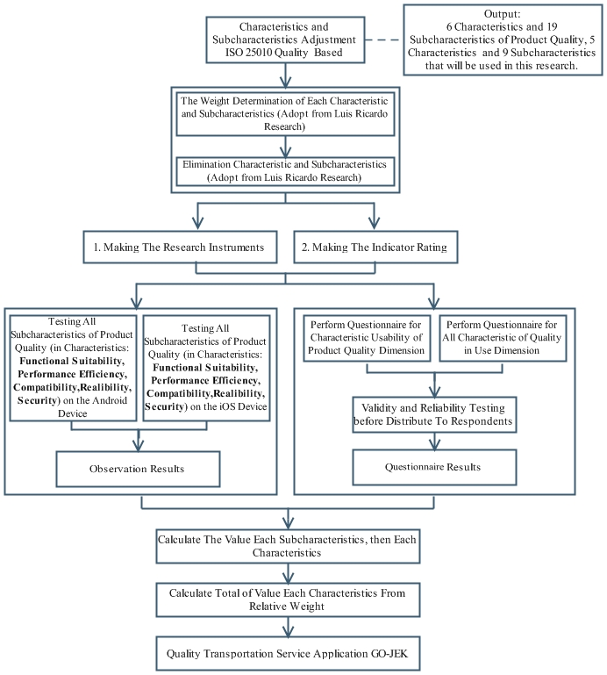
Research method

Slide 19
Adjustment of ISO 25010
Adjustment of ISO/IEC 25010 is done by giving the weighting of each
sub-characteristics, then eliminating sub-characteristics that are not relevant
to the case studies in this research.
Notes:
The research states the relatives weight of each sub characteristics ISO
25010 Quality Model should exceed the threshold to set the confidence level
reaches 90% or more and to fulfil the requirements of mobile application
market. Threshold for Quality Product dimension weight is 2% and for Quality
in Use dimension is 8% [31].

Slide 20
Weighting of Product Quality Dimension
Quality Sub-characteristics | Quality characteristics relative weight
1.1 Functional completeness | 6.18%
1.2 Functional correctness | 6.32%
1.3 Functional appropriateness | 8.22%
2.1 Time behaviour | 3.36%
2.2 Resource Utilization | 5.70%
2.3 Capacity | 3.51%
3.1 Co-existence | 2.60%
3.2 Interoperability | 2.52%
4.1 Appropriateness recognizability | 7.42%
4.2 Learnability | 3.07%
4.3 Operability | 4.75%
4.4 User error protection | 1.13%
4.5 User interface aesthetics | 5.59%
4.6 Accessibility | 2.27%
5.1 Maturity | 3.33%
Quality Sub-characteristics | Quality characteristics relative weight
5.2 Availability | 1.13%
5.3 Fault Tolerance | 0.91%
5.4 Recoverability | 1.50%
6.1 Confidentiality | 4.28%
6.2 Integrity | 4.46%
6.3 Non-repudiation | 8.00%
6.4 Accountability | 6.11%
6.5 Authenticity | 3.65%
7.1 Modularity | 0.55%
7.2 Reusability | 0.55%
7.3 Analyzability | 0.55%
7.4 Modifiability | 0.55%
7.5 Testability | 0.22%
8.1 Adatability | 0.55%
8.2 Installability | 0.66%
8.3 Replaceability | 0.33%
Notes:
Threshold for Quality Product dimension weight is 2% and for Quality
in Use dimension is 8% [31].

Slide 21
Weighting of Quality In Use Dimension
Quality Sub-characteristics | Quality characteristics relative weight
1. Effectiveness | 9.54%
2. Efficiency | 9.54%
3.1 Usefulness | 10.15%
3.2 Trust | 15.70%
3.3 Pleasure | 11.61%
3.4 Comfort | 10.06%
4.1 Economic risk mitigation | 8.60%
4.2 Health and safety risk mitigation | 8.04%
4.3 Environmental risk mitigation | 3.90%
5.1 Context completeness | 11.51%
5.2 Flexibility | 1.36%
Notes:
Threshold for Quality Product dimension weight is 2% and for Quality
in Use dimension is 8% [31].

Slide 22
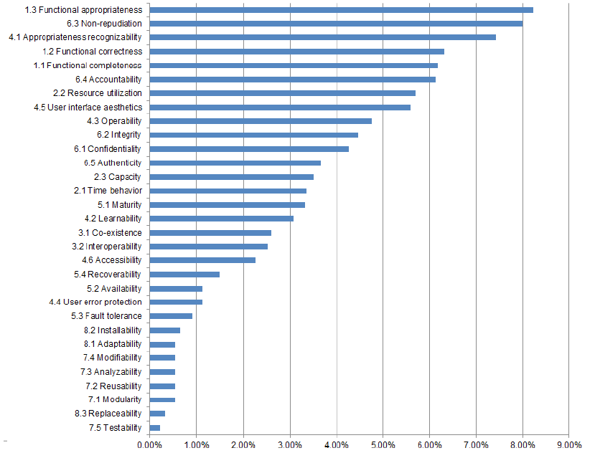
Ranking Result of Product Quality
Functional suitability characteristics can be considered as the most relevant characteristics, as seen from all sub-characteristics of Functional
suitability, such as Functional appropriateness, Functional correctness, and Functional completeness dominant get a high ranking.

Slide 23
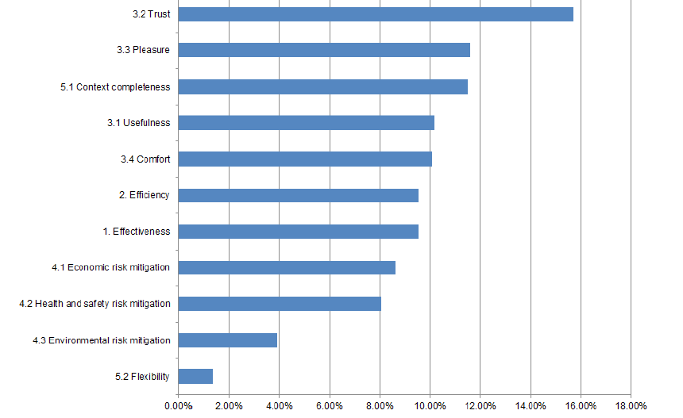
Ranking Result of Quality In Use
Satisfaction characteristics can be considered as the most relevant, as seen from all sub-characteristics of Satisfaction, such as Usefulness, Trust, Pleasure and Comfort dominant
get high ranking.

Slide 24
Elimination Result
Product Quality
6 characteristics
19 sub characteristics
Quality in Use
5 characteristics
9 sub characteristics

Slide 25
Research Instruments
The research instrument consists of instruments to test software based on any characteristics of the ISO 25010 Quality Model in Product Quality dimension and Quality in Use dimension. The research instrument designed to measure the quality of transportation service application GO-JEK based on any characteristics with quantitative assessment.

Slide 26
Research Instruments on Product Quality
Functional Suitability
(Observation to the function that exist in the GO-JEK application)
Functional Appropriateness
(Observation of 4 Transportation Service Application, produce 22 Statements of Function)
Functional Completeness
(Observation of Transportation Service Application GO-JEK, produce 112 Statements of Function)
Functional Correctness
(Observation of Transportation Service Application GO-JEK, produce 112 Statements of Function)

Slide 27
Research Instruments on Product Quality
Performance Efficiency
(Observation the GO-JEK application that related to the processing time, resources and capacity)
Time Behavior
(Observation of the functions on GO-JEK apps related to user satisfaction in the processing time, produce 112 test case)
Resource Utilization
(Observation of 4 Transportation Service Application by measuring the average of resources use, such as RAM and Memory when installation and executed)
Capacity
(Observations of the functions related to the capacity when GO-JEK apps being used, produce 4 test case)

Slide 28
Research Instruments on Product Quality
Compatibility
(Observation to the functions that exist in the GO-JEK apps related to interaction and sharing resources and information with other devices and operating system)
Coexistence
(Produce 8 test case related to ability of GO-JEK when running on the other device)
Interoperability
(Observation of the functions which interact with other system, produce 7 test case)

Slide 29
Research Instruments on Product Quality
Usability
(Adapting USE Questionnaire of Lund A.M, produce 11 statements)
Appropriateness Recognizability
Learnability
Operability
User Interface Aesthetics
Accessibility

Slide 30
Research Instruments on Product Quality
Reliability
(Observation to the functions related
to reliability of GO-JEK application when it’s being used under certain condition)
Maturity
(Produce 4 test case related to ability GO-JEK to survive from the failure or software error)

Slide 31
Research Instruments on Product Quality
Security
(Based on Research (Islam & Paolo) using Goal-Question Metrics / GQM)
Confidentially
(Produce 7 test case related to registration functions)
Integrity
(Produce 5 test case related to registration functions)
Non-repudiation
(Produce 4 test case related to provide evidence )
Accountability
(Produce 4 test case related to user’s activities)
Authenticity
(Produce 4 test case)

Slide 32
Research Instruments on Quality In Use
Quality in Use
(Adapting USE Questionnaire of Lund A.M, produce 15 statements)
Satisfaction
Effectiveness
Efficiency
Freedom from Risk
Context Coverage

Slide 33
Respondents Characteristics

Slide 34
Product Quality Testing Result on Android Device
Characteristics | Relative Weight | Subcharacteristics | Relative Weight per sub char (Wn) | Level (Ln) | Value Subchar (valueSCn) | Value char (valueCn)
1. Functional Suitability | 20.72% | 1.1 Functional Completeness | 6.18% | 5 | 6.18% | 20.72%
 |  | 1.2 Functional Correctness | 6.32% | 5 | 6.32%
 |  | 1.3 Functional Appropriateness | 8.22% | 5 | 8.22%

Slide 35
Product Quality Testing Result on Android Device
Characteristics | Relative Weight | Subcharacteristics | Relative Weight per sub char (Wn) | Level (Ln) | Value Subchar (valueSCn) | Value char (valueCn)
2. Performance Efficiency | 12.57% | 2.1 Time Behaviour | 3.36% | 4 | 2.68% | 10.75%
 |  | 2.2 Resource Utilization | 5.70% | 4 | 4.56%
 |  | 2.3 Capacity | 3.51% | 5 | 3.51%

Slide 36
Product Quality Testing Result on Android Device
Characteristics | Relative Weight | Subcharacteristics | Relative Weight per sub char (Wn) | Level (Ln) | Value Subchar (valueSCn) | Value char (valueCn)
3. Compatibility | 5.12% | 3.1 Co-existence | 3.36% | 5 | 2.60% | 4.62%
 |  | 3.2 Interoperability | 2.52% | 4 | 2.02%

Slide 37
Product Quality Testing Result on Android Device
Characteristics | Relative Weight | Subcharacteristics | Relative Weight per sub char (Wn) | Level (Ln) | Value Subchar (valueSCn) | Value char (valueCn)
4. Usability | 23.10% | 4.1 Appropriateness Recognizability | 7.42% | 4 | 5.94% | 18.48%
 |  | 4.2 Learnability | 3.07% | 4 | 2.45%
 |  | 4.3 Operability | 4.75% | 4 | 3.80%
 |  | 4.5 User Interface Aesthetics | 5.59% | 4 | 4.47%
 |  | 4.6 Accessability | 2.27% | 4 | 1.82%

Slide 38
Product Quality Testing Result on Android Device
Characteristics | Relative Weight | Subcharacteristics | Relative Weight per sub char (Wn) | Level (Ln) | Value Subchar (valueSCn) | Value char (valueCn)
5. Reliability | 3.33% | 5.1 Maturity | 3.33% | 4 | 2.66% | 2.66%

Slide 39
Product Quality Testing Result on Android Device
Characteristics | Relative Weight | Subcharacteristics | Relative Weight per sub char (Wn) | Level (Ln) | Value Subchar (valueSCn) | Value char (valueCn)
6. Security | 26.53% | 6.1 Confidentiality | 4.28% | 5 | 4.28% | 22.07%
 |  | 6.2 Integrity | 4.46% | 4 | 3.56%
 |  | 6.3 Nonrepudiation | 8.00% | 4 | 6.4%
 |  | 6.4 Accountability | 6.14% | 4 | 4.91%
 |  | 6.5 Authenticity | 3.65% | 4 | 2.92%

Slide 40
Product Quality Testing Result
Result | Sum of Total Relative Weight | Total Weights Testing Result
Product Quality Testing Result on Android Device | 91.37% | 79.30%
Product Quality Testing Result on iOS Device |  | 80.88%

Slide 41
Quality in Use Testing Result
Characteristics | Relative Weight | Subcharacteristics | Relative Weight per sub char (Wn) | Level (Ln) | Value Subchar (valueSCn) | Value char (valueCn)
1. Effectiveness | 9.54% | 1. Effectiveness | 9.54% | 4 | 7.63% | 7.63%
2. Efficiency | 9.54% | 2. Efficiency | 9.54% | 4 | 7.63% | 7.63%
3. Satisfaction | 47.52% | 3.1 Usefulness | 10.15% | 4 | 3.56% | 38.44%
 |  | 3.2 Trust | 15.70% | 4 | 6.4%
 |  | 3.3 Pleasure | 11.61% | 4 | 4.91%
 |  | 3.4 Comfort | 10.06% | 4 | 2.92%

Slide 42
Quality in Use Testing Result
Characteristics | Relative Weight | Subcharacteristics | Relative Weight per sub char (Wn) | Level (Ln) | Value Subchar (valueSCn) | Value char (valueCn)
4. Freedom from risk | 16.64% | 4.1 Economic risk mitigation | 8.60% | 4 | 6.88% | 22.52%
 |  | 4.2 Health and safety risk mitigation | 8.04% | 4 | 6.43%
5. Context Coverage | 11.51% | 5.1 Context Completeness | 11.51% | 4 | 9.21% | 9.21%

Slide 43
Quality in Use Testing Result
Result | Sum of Total Relative Weight | Total Weights Testing Result
Quality in Use Testing Result | 94.75% | 76.22%

Slide 44
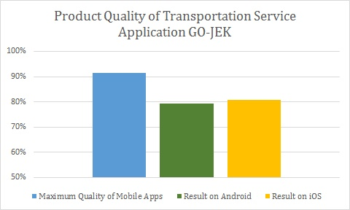
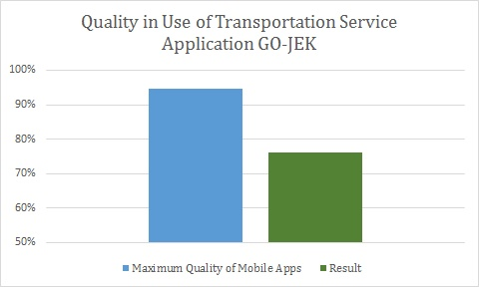
Chart Result

Slide 45
Conslusion
Measuring the quality of trasnportation service application GO-JEK using ISO 25010 Quality Model has been successfully carried out by the methods that have been determined.

Slide 46
Conslusion
GO-JEK application obtain the value of good quality with a percentage on product dimensional quality is equal to 79.30% on a android device and on iOS devices 80.88% of the maximum value of mobile application quality by 91.37%. This shows the application GO-JEK have good quality in terms of functional, performance, compatibility, usability, reliability and security. GO-JEK quality of applications in the operating system iOS has a value of higher quality than the android operating system for iOS for some sub characteristic are at a higher level than the android. Subcharacteristic is Operability, Integrity and time behavior. This indicates that the quality of the GO-JEK better on iOS devices to provide ease of operation, preventing the access rights and response time.

Slide 47
Conslusion
Quality in Use dimension, the quality of transportation service application GO-JEK is 76.22% of the maximum value of mobile application quality is 94.75%. The results of the weight difference of Quality in Use dimension and maximum of quality mobile applications is 18.53%. Overall, quality transportation service application GO-JEK has been good from the user’s perspective, for each characteristic is at level 4 is the predicate good quality.

Slide 48
Future Works
Measuring the quality of trasnportation service GO-JEK using ISO 25010 Quality Model is open to be developed. Measuring the quality of service application trasnportation GO-JEK needs to be done with various types of testing that is more diverse and need to use tools for multiple characteristics on dimensions of product quality, so we get more accurate results. In addition to filling out the questionnaire on usability characteristics and dimensions of quality in use need to be spread area in the Indonesian region that has been reached by the application GO-JEK.

Slide 49
Thank You

